Slide 1
SCME MEMS
Educational Modules Implementation Progress
Ivy Tech Community College
Northeast – Andy Bell

Slide 2
Accomplishments & Plans
SCME Educational Materials (MEMS Learning Modules and Resources) already used:
Pressure Sensor Process Activity and Kit
Kit used in one courses (EECT 111) which typically runs twice a year.
All students documented the results in their lab notebook
This is typically runs as multiple team projects (2-3 students)
Plans to expand the use of kit into both EECT 112 and ENGT 120
EECT 111 will also build and interface a preamp
EECT 112 is the Digital Fundamentals course take preamp output and digitize it.
ENGT 120 is our intro to engineering course to characterize and build calibration curves.

Slide 3
Accomplishments & Plans (cont)
Pressure Sensor Process Activity and Kit
Built Arduino UNO module and wrote LabView code to interface to a modified Pressure Sensor
New “Electronic Kit” presented at the 2015 MNT Conference.

Slide 4
Accomplishments & Plans (cont)
Dynamic Cantilever Activity and Kit
Kit used in one courses (METC 111) which typically runs twice a year.
All students documented the results in their lab notebook
This is typically run as a single class project
Plans to include this kit in EECT 111 Intro to Circuit Analysis
Built Arduino UNO module and wrote LabView code to interface to a modified Cantilever Kit
Built custom strain gauges using silver ink and Cameo Vinyl Cutter
New “Electronic Kit” presented at the 2015 MNT Conference.

Slide 5
Accomplishments & Plans (cont)
Crystallography Activity and Kit
Kit used in one courses (METC 143) which typically runs twice a year.
All students documented the results in their lab notebook
Class divided into three teams:
(1) Activity Breaking Wafers Activity,
(2) The Miller Index Activity and Kit and
(3) An Origami Crystal Activity.
Teams present results to the class and documented results in
Lab Notebook.
See http://www.ivytechengineering.com website
New domain created @ http://faculty.ivytech.edu/~mems/

Slide 6
Student and Faculty Impacts
Programs: Engineering Technology & Electrical Engineering Technology
Courses: EECT 111, METC 111 and METC 143
Class size ~ 14 students per course and each course run Fall and Spring semesters.
Instructors: 3 instructors have used the kits
Growth Courses: ENGT 120, EECT 111 & EECT 112.
Class size ~ 14 students per course and each course run Fall and Spring semesters.
Instructors: 3 instructors will used the kits

Slide 7
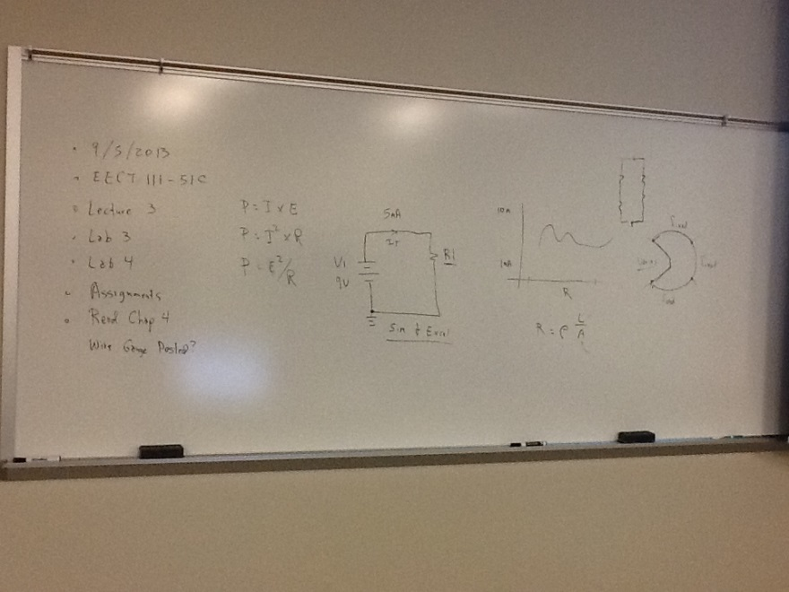
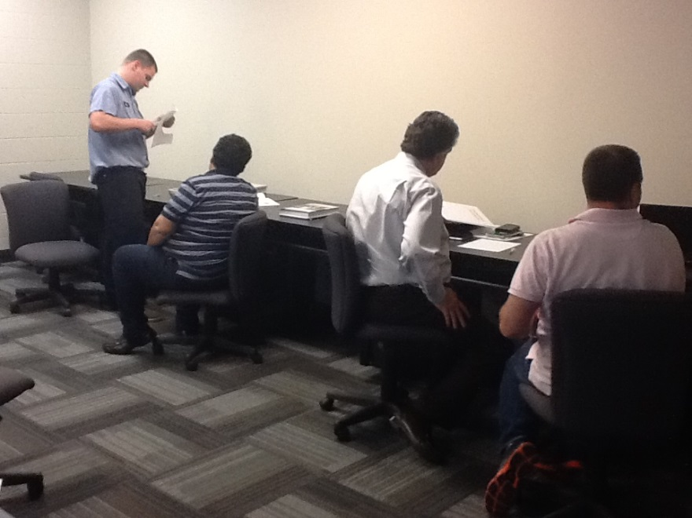
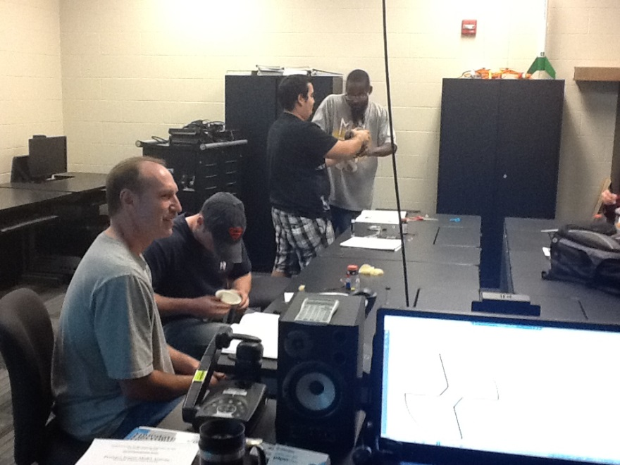
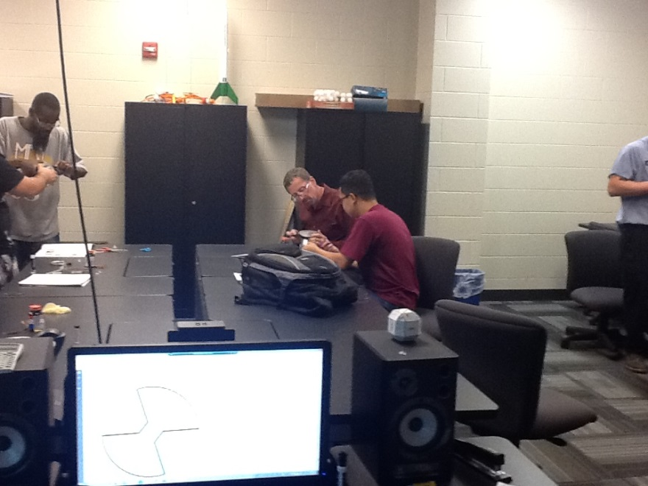
Student Impacts

Slide 8
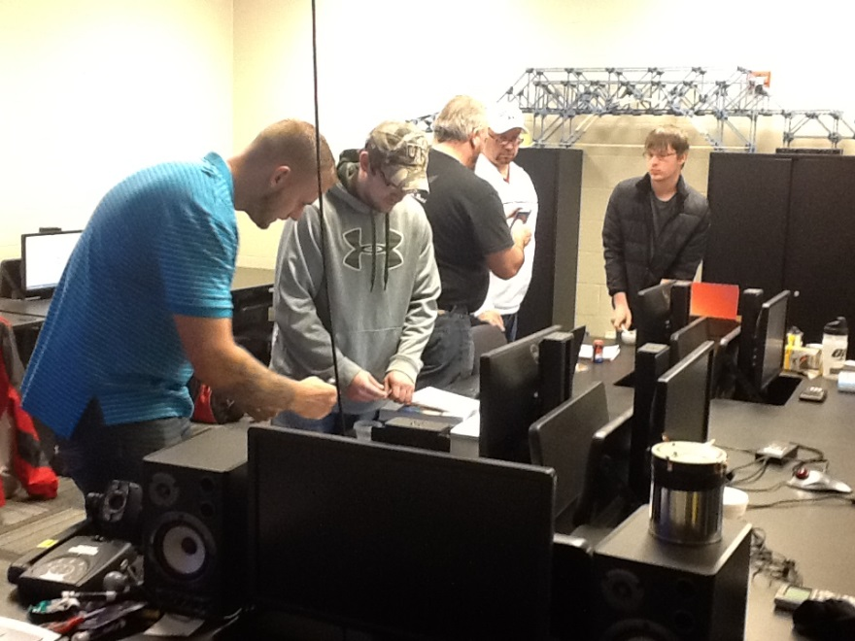
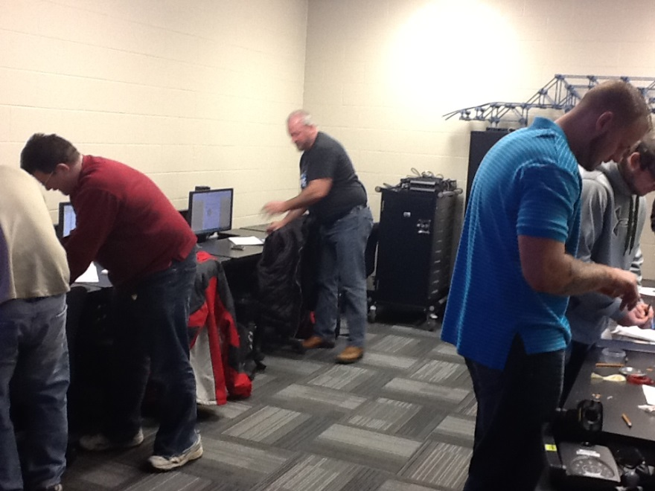
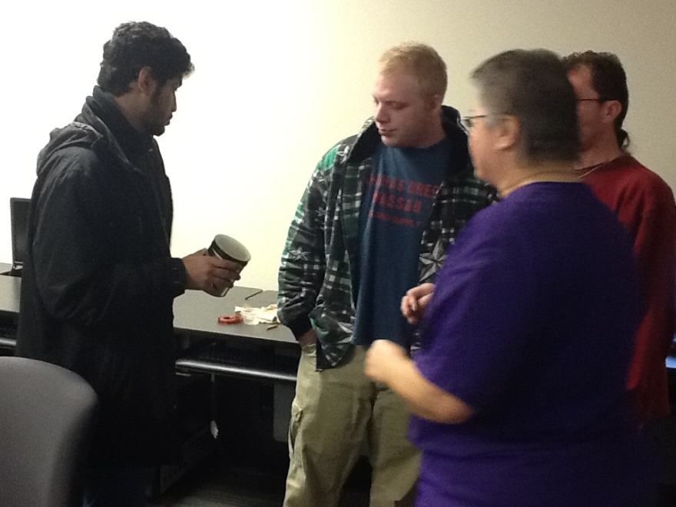
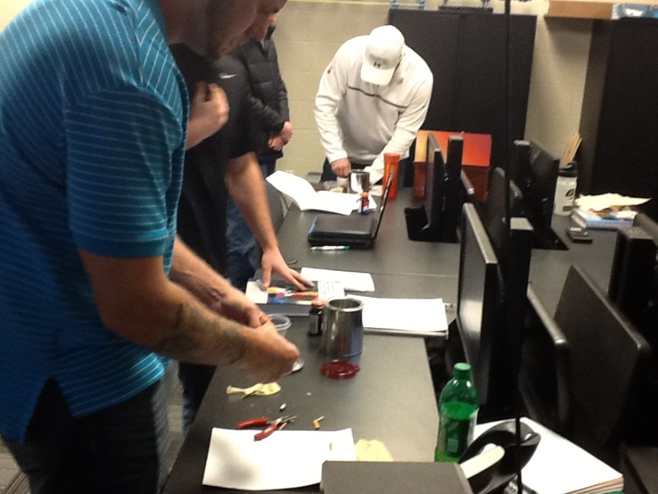
Student Impacts

Slide 9
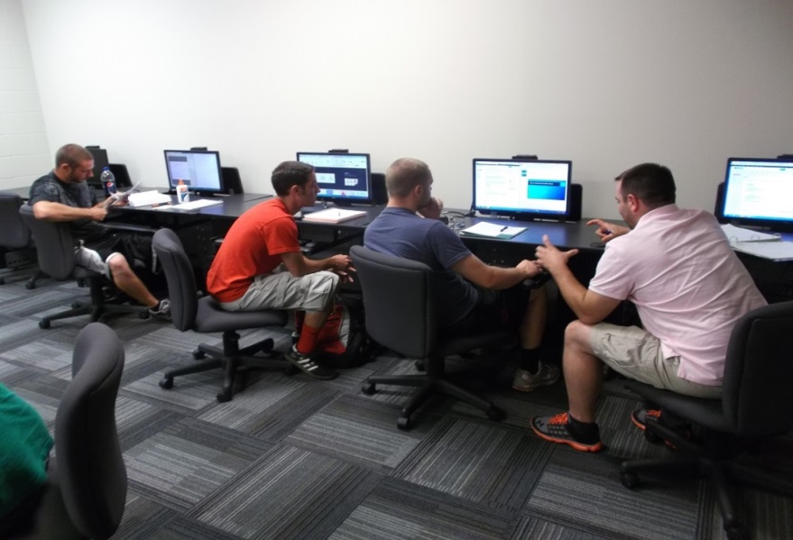
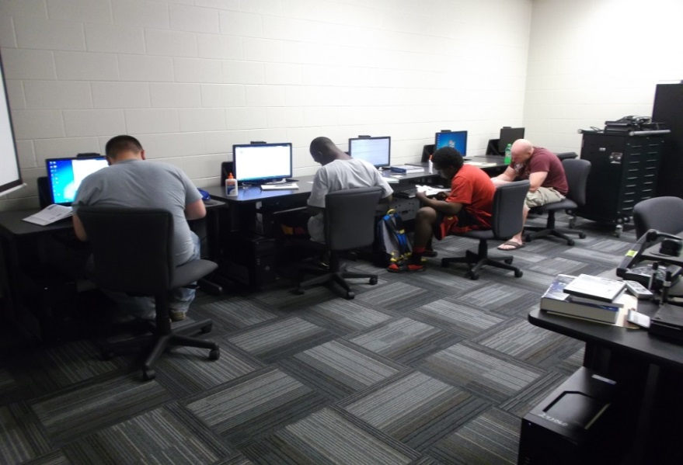
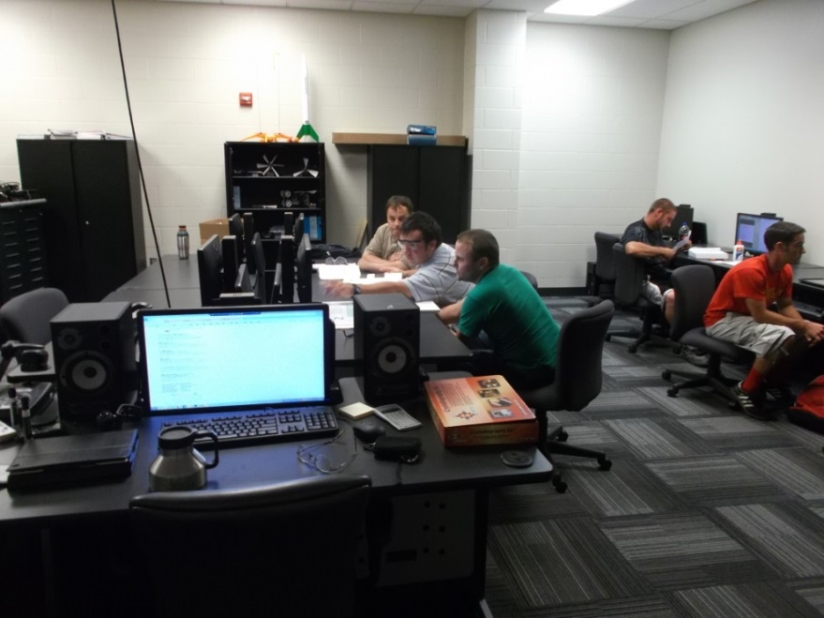
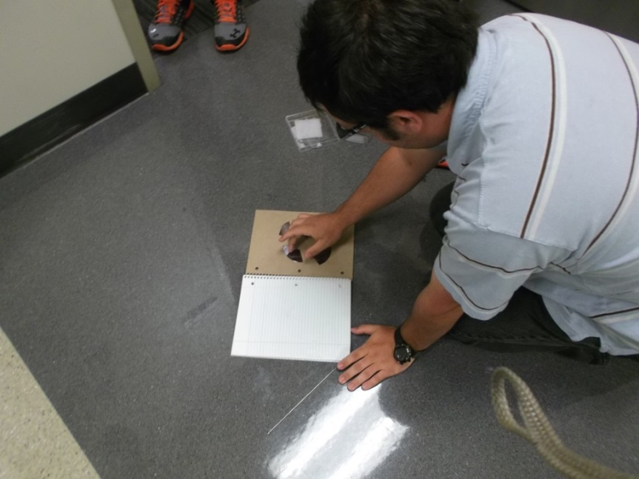
Student Impacts

Slide 10
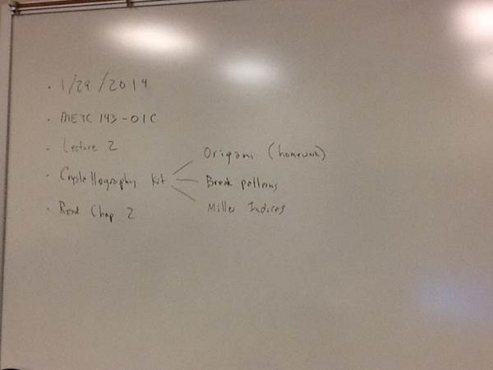
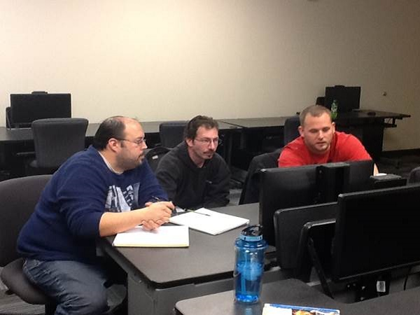
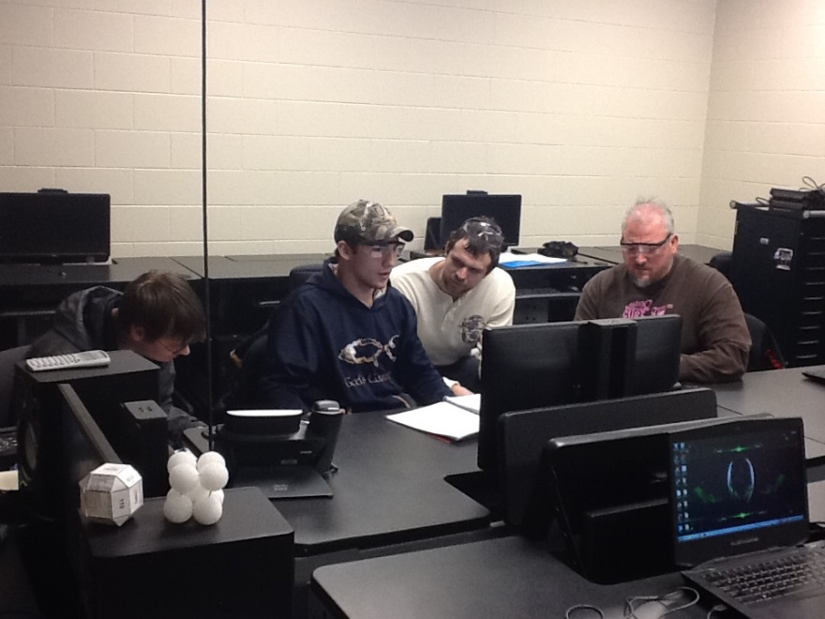
Student Impacts

Slide 11
Implementation Plans
MEMS Kits Implementation Plan IVY TECH - Northeast
SL | MEMS Kit | ENGT 120 | METC 111 | METC 143 | EECT 111 | EECT 112 | ENGR 251 | ENGT 279 | Proposed Number of Classes Per Kit
1 | MEMS: Making Micro Machines Kit | X |  |  |  |  |  |  | 1
2 | Dynamic Cantilever Kit |  | X | X | X |  | X |  | 4
3 | Crystallography Kit |  |  | X |  |  |  |  | 1
4 | Pressure Sensor Model Kit | X |  |  | X | X | X |  | 4
5 | GeneChip Model Kit | X |  |  |  |  |  |  | 1
6 | MEMS Innovators Kit |  |  |  |  |  |  | X | 1
7 | Lift-off Kit |  |  | X | X |  |  |  | 2
8 | Pressure Sensor Process Kit |  |  |  | X |  |  |  | 1
9 | LIGA Micromachining Simulation Kit |  |  | X |  |  |  |  | 1
10 | Anisotropic Etch Kit |  |  | X | X |  |  |  | 2
11 | Rainbow Wafer Kit | X |  |  |  |  |  |  | 1
 | Proposed Number of Kits Per Class | 4 | 1 | 5 | 5 | 1 | 2 | 1
 | *** Course Title**** ENGT 120: Engineering Concepts in Technology METC 111: Statics METC 143: Materials and Processes Courses EECT 111: Introduction to Circuit Analysis EECT 112: Digital Fundamentals ENGR 251: Electrical Circuits I ENGT 279: Portfolio Preparation

Slide 12
Professional Developments
Dr Kesler & Matthew Krueger attended 2014 ATE PI Conference in DC
Matthew selected to participate at the conference by AACC
(American Association of Community Colleges)
Andy presented at MNT Conference 2015, North Seattle College, Seattle, WA.
Andy completed LabView Core 1 & 2 training (July 6 -10)
Andy attending Hi-Tec Conference in Portland, OR, July 27-30.
Ivy Tech faculty and students plan to travel to UNM in early August

Slide 13
Questions??

